Slide 1
An Introduction to Machine Learning
The implementation and interpretation of key models
Terence Parr
MSDS program University of San Francisco

Slide 2
Course topics
Regularization of linear models (finishes off linear regression topic)
Models (Naïve Bayes, kNN, Decision trees, Random Forests)
Model interpretation (feature importance)
Clustering (k-means, hierarchical clustering)
In ML Lab course:
Data clean up, feature engineering, dealing with missing data
Model assessment (metrics, ROC/PR curves)
A book to become familiar with:
The Elements of Statistical Learning: https://web.stanford.edu/~hastie/Papers/ESLII.pdf

Slide 3
Before we jump in…
Let’s take a quick high-level overview, identify the key ideas
What problem are we solving?
What does it mean to train a model?
Training data, features
What doesn’t look like in Python?
Model assessment
Train, validate, test

Slide 4
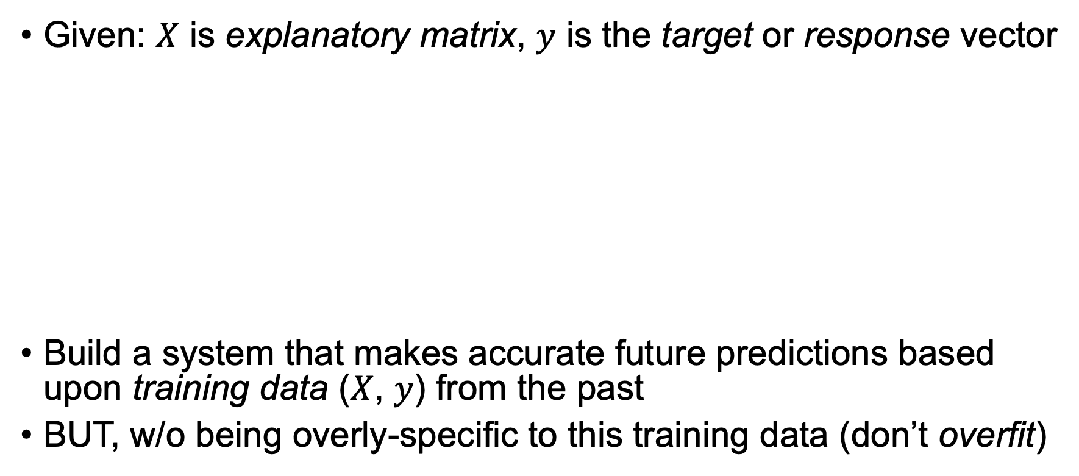
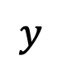

Central problem of machine learning
supervised
^
Given: $X$ is explanatory matrix, $y$ is the target or response vector
Build a system that makes accurate future predictions based upon training data ($X$, $y$) from the past
BUT, w/o being overly-specific to this training data (don’t overfit)
$$X$$
$$y$$
observations
or
records

Slide 5
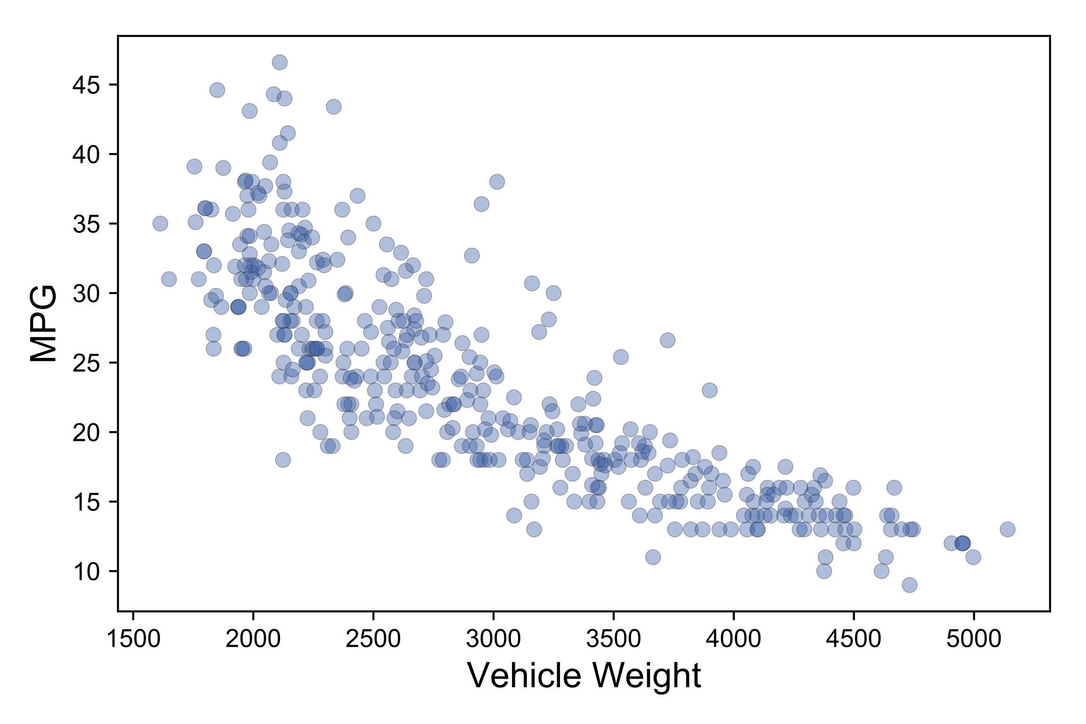
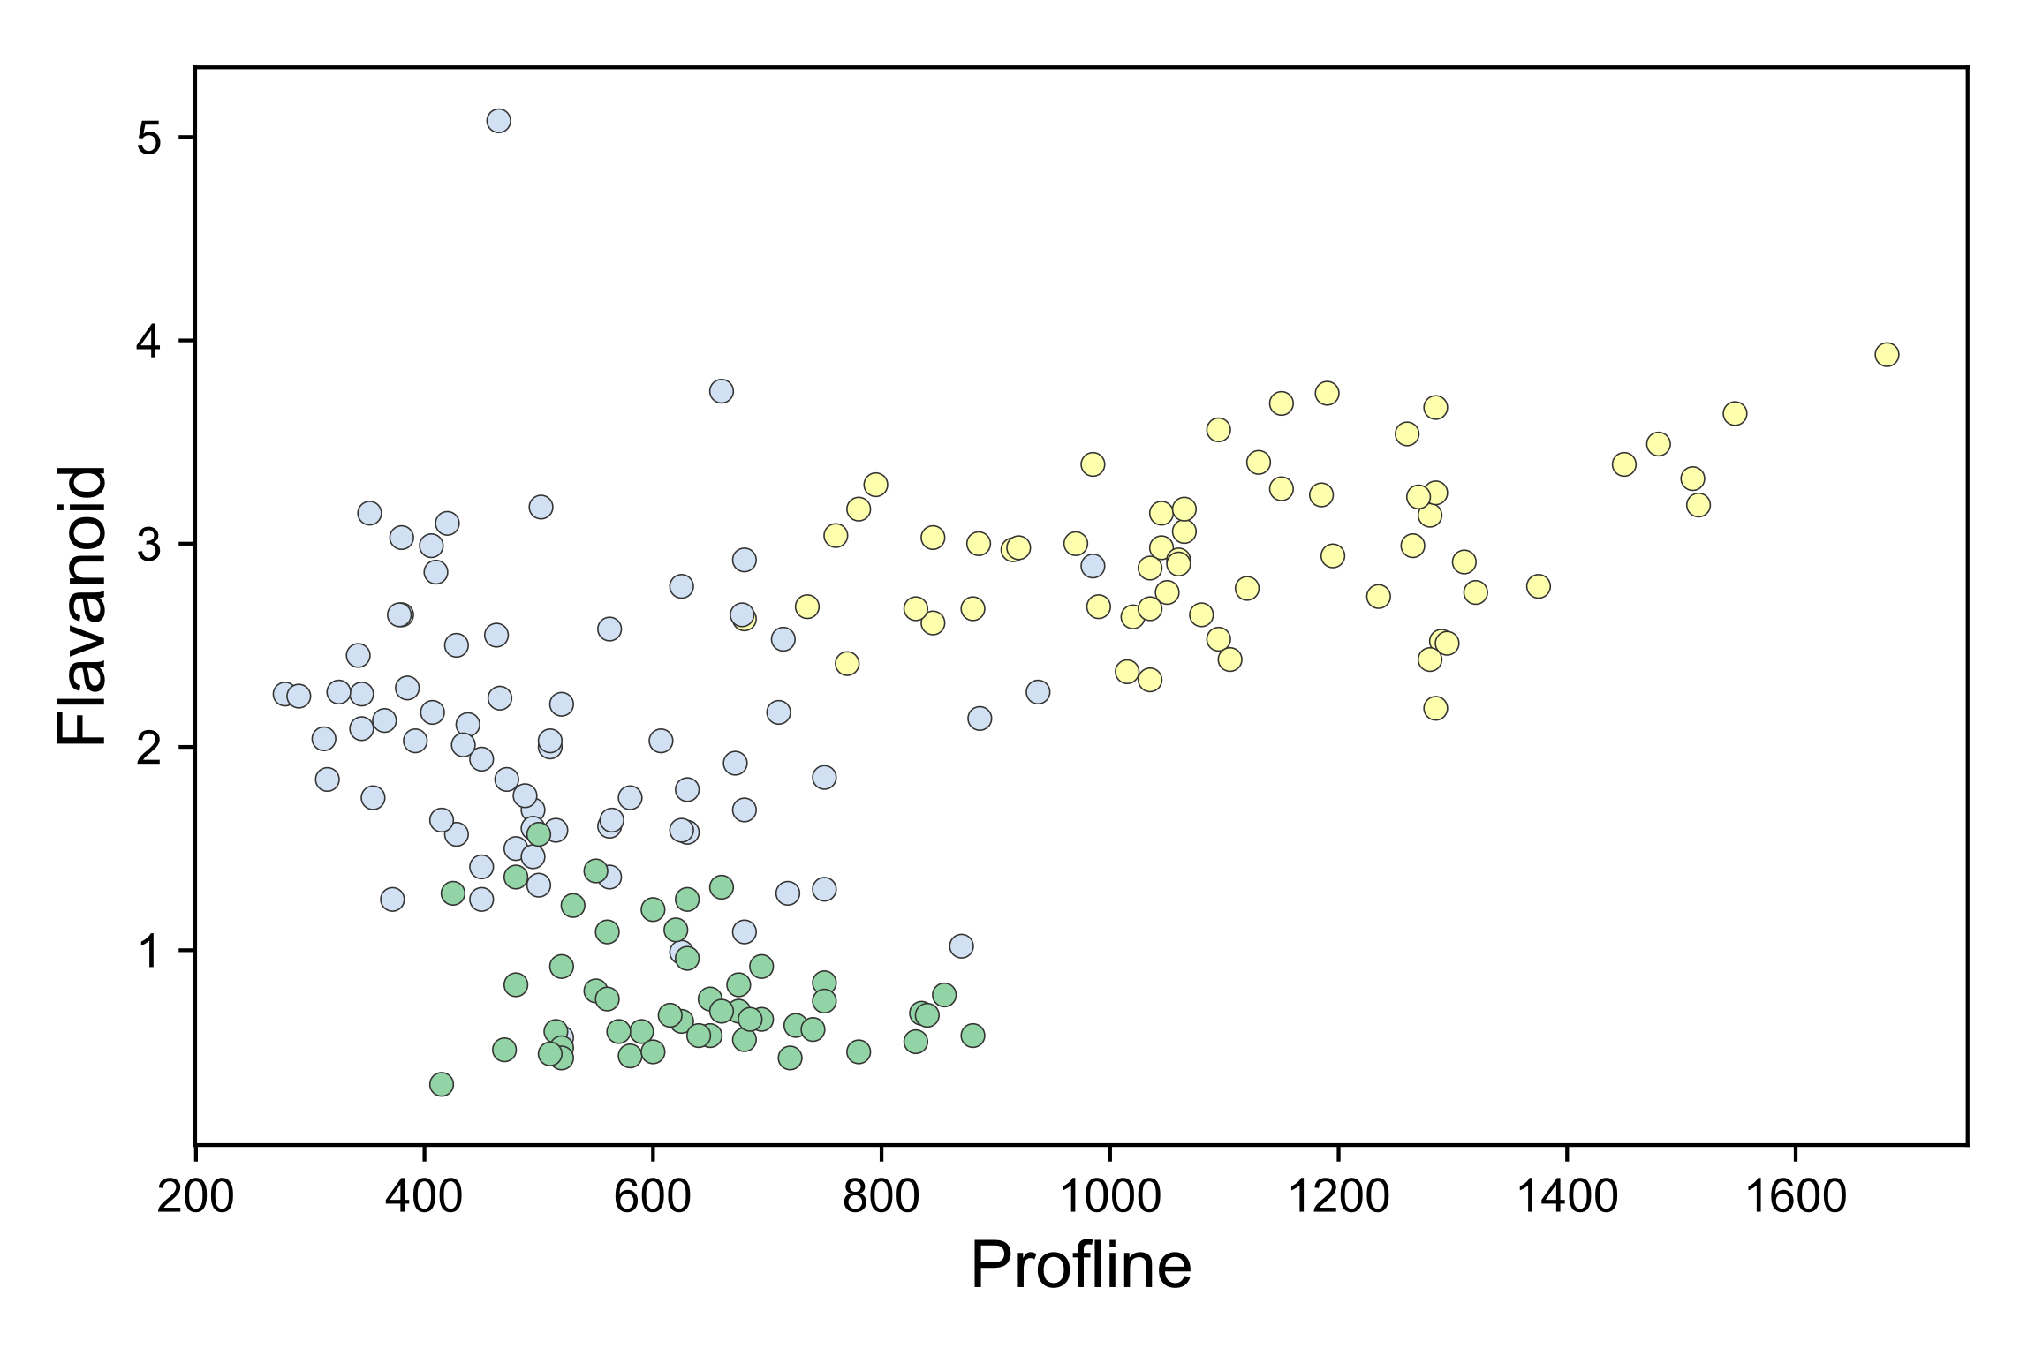
Regressor vs Classifier; 2 sides of same coin
If target is numerical, model is a regressor
If target is categorical, model is a classifier
Regressors draw through data, classifiers draw between clusters
curve fit
decision surfaces

Slide 6
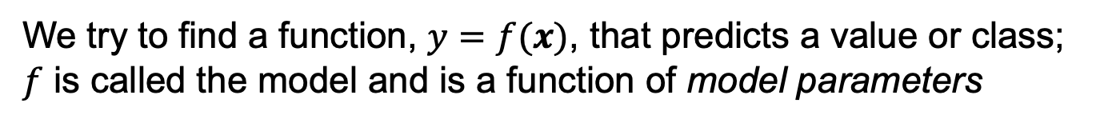
Different models have different surfaces
We try to find a function, $y=f(x)$, that predicts a value or class;
$f$ is called the model and is a function of model parameters

Slide 7
The model is just the decision surface(s)
In a sense, a model is a condensation or compression of training data

Slide 8
Training (fitting) a model
Distill training data into model parameters
Hyperparameters control distillation, parameters are the condensate
Parameters:
beta coefficients for linear model
tree structure (split vars/vals, …) for decision tree
kNN is extreme where data are the parameters
Hyperparameters: num trees, learning rate, …
A model = algorithm + parameters
Algorithm could be linear math equation or decision tree walker etc…
Training is usually a lossy compression; e.g., linear regression of 2 vars condenses any amount of data down to 3 floats!!

Slide 9
A good model is all about the features
Good features are usually more important than the model
Example: 3-word voice recognition, HMM vs Rocchio
Focus on feature engineering not choosing the model
Your default models:
For structured data, use random forests or boosted trees
For unstructured (like images), use neural networks (nets of linear models)
Generally speaking, these models are tolerant of noise and superfluous features
Means we can throw every feature we can think of at model
Caveat: deep learning computes its own features from raw data

Slide 10
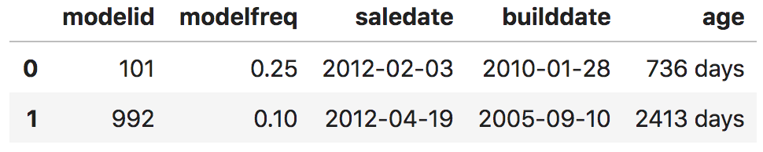
Feature engineering
Synthesize new features from existing features
A few common synthesized features:
frequency encoding; e.g., getting info about records from ID feature
e.g., derive age from sale and manufacturing dates
Or, derive from external sources; e.g., isholiday from date
Synthesized features

Slide 11
What training, prediction look like in code
In scikit-learn, swapping out model is trivial:
LinearRegression and RandomForest are objects representing models and hyperparameters go in as args to constructor
We’re going to build our own versions as class projects
lm = LinearRegression()
lm.fit(X, y)
rf = RandomForestRegressor()
rf.fit(X, y)
x = [[2, 1, 40.794, -74.00]]
y_pred = lm.predict(x)
x = [[2, 1, 40.794, ...]]
y_pred = rf.predict(x)

Slide 12
Is our model any good?
Define good? Good at what?
My answer: good if model makes useful predictions on unknown, future feature vectors (it generalizes)
Might not be super accurate, but if it’s better than a human can do, might still be useful
We measure how close predictions are to known true responses, but on data not used to train model
If inaccurate on training data, model is biased
If inaccurate on test set, model doesn't generalize (high variance)
Regressors: R^2, MAE, MSE, RMSE, RMSLE
Classifiers: accuracy, precision & recall, F1, confusion matrix, …

Slide 13
Train, validate, test
One of the most important, fundamental ideas in ML
See “The testing trilogy” in MML book
3 sets of observations: training, validation, and test sets
Model trains on training set; assess and tune with validation set
NEVER peek at the test set; lock it away as first step
Assess model w/test set as last step; it’s the only true measure of generality
Every change to model after testing with a data set tailors it to that set
Validation strategies: k-fold CV, hold out, leave-1-out, out-of-bag (RF), …
3-fold cross-validation
https://mlbook.explained.ai/bulldozer-testing.html#sec:trilogy

Slide 14
Simplified ML process
Know what problem you’re solving; what is business case?
Acquire data, do we have everything we need?
Split into train, validation, test sets
Sniff data, clean, deal with missing data
Convert non-numeric features to numeric
Repeat until satisfied
Train a model using training set and specific hyperparameters
Tune model and do feature engineering with validation set
Last step: assess model performance on a test set

Slide 15
Your model development environment
See https://mlbook.explained.ai/tools.html
Pandas, NumPy, matplotlib, scikit-learn (sklearn)
Jupyter lab (or notebook)
Install latest Anaconda for Python 3

Slide 16
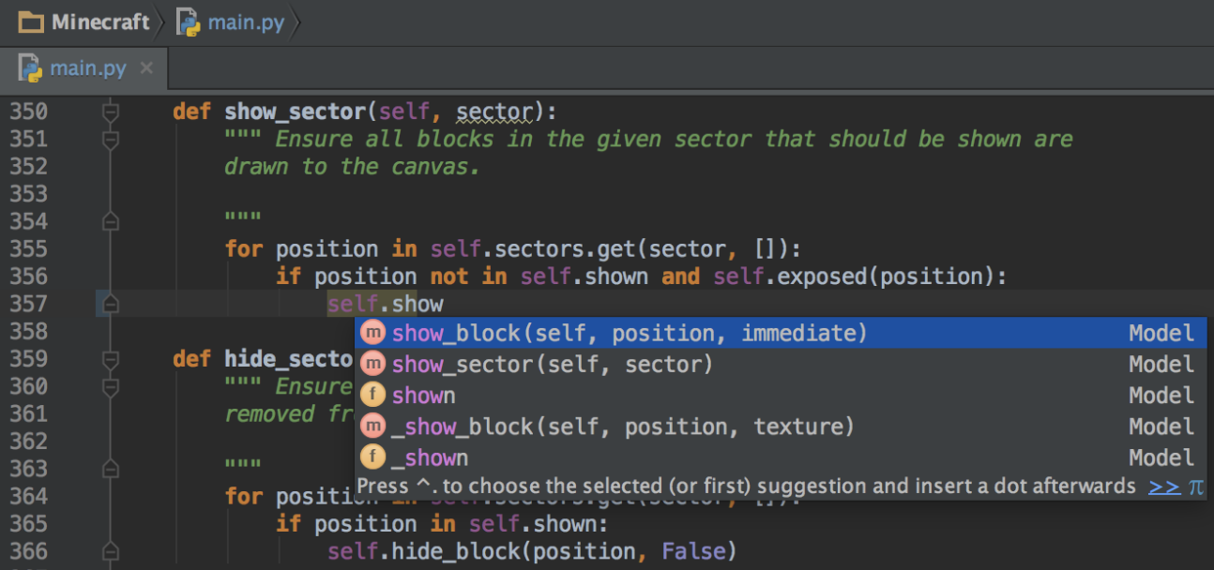
Your library development environment
You will create separate Python .py scripts and use unit tests as part of the projects
I recommend PyCharm development environment (free) for creating python files, but you are free to use whatever you like
https://www.jetbrains.com/pycharm/download

Slide 17
Getting started in MSDS621
We’ll start with regularization to finish off linear models
Then we’ll try to reinvent some common machine learning models
As part of this class, you will build up a library of models
Then, learn how to interpret model results
Then an intro to deep learning with pytorch
Etc…

